Slide 1
Welcome!
Lesson 5: Social Role – Building Community
Instructor: Collice I

Slide 2
Learning Objectives
Discuss the impact of community on learning rates, retention rates, and student satisfaction.
Determine the role that community will play in a specific course.
Evaluate a teaching assignment and select an appropriate ice breaker and initial facilitation strategies to encourage the development of a learning community during the initial week of a course.
Develop facilitation strategies to enhance the ongoing maintenance of community from beginning to the end of the course.
Evaluate Facebook as a usable Social Media tool in the classroom.

Slide 3
Building Community - Lecturette

Slide 4
What is a Learning Community?

Slide 5
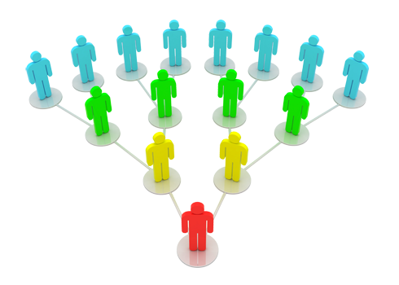
Five Roles I Play in Online Courses - Scot Headley
Space Planner
Pacesetter
Host
Connector
Mirror

Slide 6
Shaping the Metaphor of Community in Online Learning Environments Richard A. Schwie
Community – Metaphor educators developed for the kinds of learning environments we hope to develop online.
Virtual Learning Environment – individuals take advantage of, invent a process for engaging ideas, negotiating meaning and learning collectively.
Virtual learning environments don’t always turn into virtual learning communities.

Slide 7
Elements of Virtual Communities
Historicity
Identity
Mutuality
Plurality
Autonomy
Participation
Future
Technology
Learning
Integration

Slide 8
Strategies for Collaborative Learning Soren Kaplan, Ph.D.
Ice Breakers!

Slide 9
Purpose of an Icebreaker?
Esprit de corps - a feeling of pride, fellowship, and common loyalty shared by the members of a particular group (Oxford Dictionary, 2016).

Slide 10
What are some Ice Breakers you have encountered in an online classes?

Slide 11
Facebook
Integrating Social Networks into Online Teaching

Slide 12
Using Facebook in Online Learning (video)
Pros
Cons
Creativity
Appropriate Online Citizenship
Emphasis on creating content vs just using it
Communicating about their talents and experience
Privacy Issues
Academic Freedom/Freedom of Speech
Professional vs Personal Relationships
Legal Issues

Slide 13
Online Learning using Facebook
Facebook fan pages (History Lesson)
Create a group for the class
Provide updates
Facilitate discussion within the group page
Follow News stories

Slide 14
Conclusion

Slide 15
Questions?

